Slide 1
Hot Shot Hoops
INTERNET OF THINGS
2017
By :Karan Kapoor

Slide 2
Problem
For all the people out there who love the sport of basketball, keeping track of all the shots made can be a real hassle. You wonder why steph curry is good at those 3 pointer's. Well Practice is the name of the game. All basketball coaches will tell you the more you practice the more you do well in the game. But, When you are practicing, how do you know how many times you scored today ? If steph curry scores 200 times a day at practice, How many times do you score a day at practice ?

Slide 3
Solution
Hotshot Hoops IOT Device
Our project allows someone to easily measure and keep track of baskets made in an accurate way. With just two photons, two power sources and two PIR sensors, the score will never be forgotten again.
Our score keeper is as user friendly as it gets. You don’t really need to do much, it automatically tracks the number of baskets made and display’s the result on a Google sheet, your mobile device or multiple other platforms if you require.

Slide 4
Target Audience
Our target audience are not big arena’s or school basketball courts that already have an inbuilt counter associated with the rim when they buy it
Our target audience are household’s, small or big which have a basketball rim, may it be portable or not, outside or inside the house.
Our target audience are Dads/Moms that are trying to help there kids to practice better so they invest in a basket ball rim in the house.

Slide 5
Market Research/Scalability
15.5 million people play casual/pick-up basketball. 4.1 million play in organized leagues. 5.8 million play on a school or college team. More people play basketball in the U.S. than any sport.
It is roughly stated that there are over 600,000 consumer basketball hoops sold every year. !
Now we assume that at least half of the 600,000 sold every year would buy it for kids trying to make it big in basketball.
Which means we are targeting around 300,000 sold every year .
Source : http://www.simple-simple.org/Q/05/13/how-many-basketball-hoops-are-sold-each-year/
Source https://www.sfia.org/press/433_Over-26-Million-Americans-Play-Basketball

Slide 6
How its made
Just two photons, two power sources and two PIR sensors, the score will never be forgotten again. ( For Demo only one photon, one power source and one Pir Motion sensor is used).
The PIR sensors have a wide range of few, which will mess with results if it is not corrected

Slide 7
Main Ingredient
PIR sensors allow you to sense motion, almost always used to detect whether a human has moved in or out of the sensors range. They are small, inexpensive, low-power, easy to use and don't wear out. For that reason they are commonly found in appliances and gadgets used in homes or businesses. They are often referred to as PIR, "Passive Infrared", "Pyroelectric", or "IR motion" sensors.

Slide 8
Weather Proofing
to correct this problem we facilitated the use of PVC piping. We cut out a small portion of the piping and taped it onto the breadboard of the PIR sensor. This limited it's view and allowed for accurate sensing in a singular direction .It also made sure the Sensor is not hit by heavy snow or rain.
Source Pir Sensor - https://learn.adafruit.com/pir-passive-infrared-proximity-motion-sensor?view=all
Other alternatives - https://www.amazon.com/Optex-LX-402-Weatherproof-Infrared-Detector/dp/B000FW7S8K

Slide 9
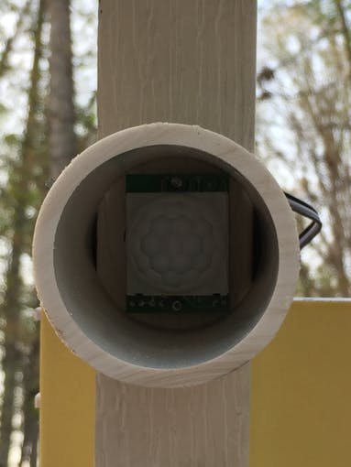
PIR MOTION SENSOR

Slide 10
Accurate Results
Once the piping portion is completed the devices need to be placed in such a way that both motion sensors can't go off if you miss a basket. In our case one motion sensor was placed on the top of the basket pointing down into the net. The other one was placed on the left bottom side of the backboard directed just under the net. This meant that the likelihood of a miss being counted was sufficiently minimized to get accurate results.

Slide 11
Accurate Results
We also included led lights on each breadboard configuration. They were included to further indicate whether or not a basket was made outside of getting a message. If both led's light up within about three seconds, the basket will count. This was also to show if the program was running correctly. When the PIR sensor is activated the led should light up shortly after. If the led doesn't, the sensor may not have picked up the motion and or the setup may be flawed.

Slide 12
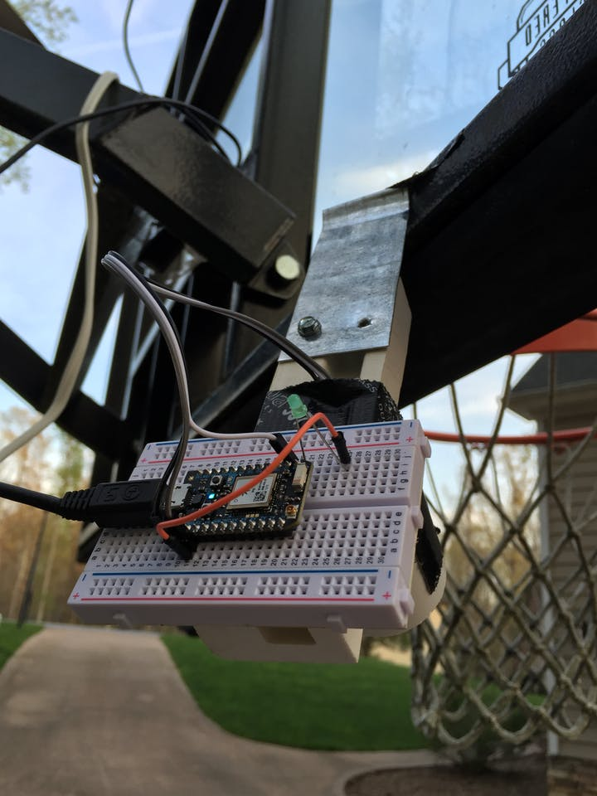

Slide 13
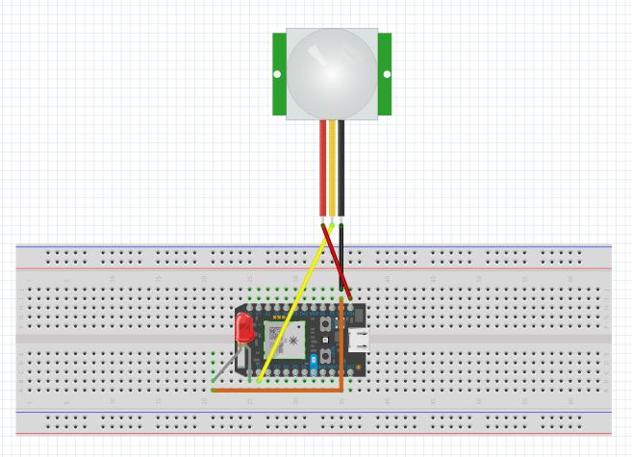
Circuit

Slide 14

Code

Slide 15
Display results
IFTTT
Short for “If This, Then That,” IFTTT is an easy way to automate tasks that might otherwise be repetitive or unable to talk to each other. It works like this: users are guided through a process to make simple scripts, aka “recipes,” where some type of event in one device or service automatically triggers an action in another. IFTTT is also completely free, and well supported. There are now more than 300 channels — which are what you reference when creating recipes — spread across a range of devices and services, including social networks, smart appliances, smart home systems, and devices such as weather stations, audio systems, and wearable's.
We can also create a web hook and publish the data through it

Slide 16
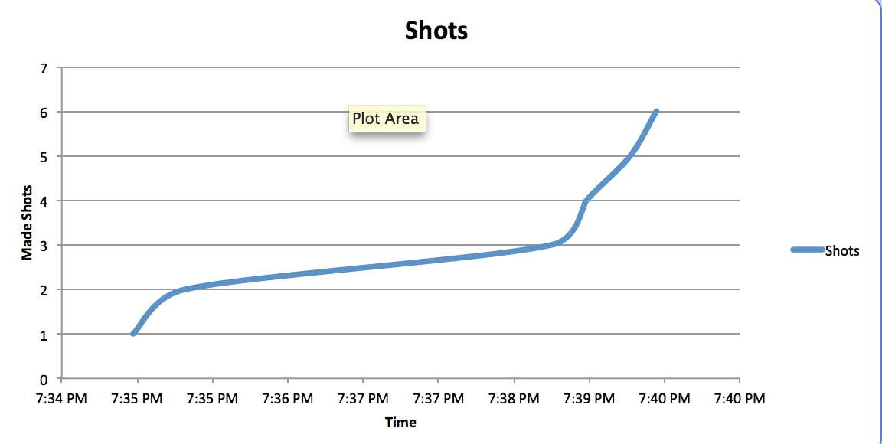
Data Graph

Slide 17
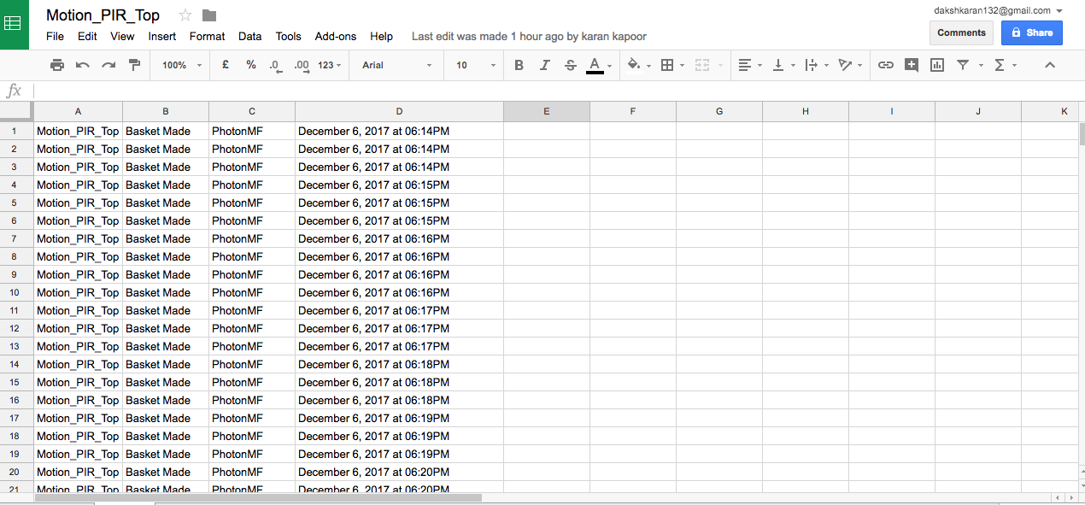
Google Sheet

Slide 18
Sources
Source - https://particle.hackster.io/iot-basketball/hot-shot-hoops-539e3e?ref=channel&ref_id=286_trending___&offset=77
Video - https://www.youtube.com/watch?v=cYe7IvPfVyw

Slide 19
QUESTIONS ?

